Slide 1







Technology Survey Results
Crisenger Guerisma
1/31/2024

Slide 2



OUTLINE
Executive Summary
Introduction
Methodology
Results
Visualization – Charts
Dashboard
Discussion
Findings & Implications
Conclusion
Appendix

Slide 3

EXECUTIVE SUMMARY
Objective: To Analyze the 2022 technology survey results conducted by StackOverFlow
Analysis of this year’s result:
Top programming languages used
Top databases used
Platforms used
Top webframes used
Analysis of the results for respondent’s next year learning plans:
Top programming languages
Top databases
Platforms
Top webframes
Analysis of the respondent’s demographics
Respondent Gender, Age, Country and Education Level

Slide 4

INTRODUCTION
Analyze the survey results data looking for trends and implications of the following
Technology used this year by respondents
Technology learning plans, and usage for next year
Analyze the demographic distribution of the respondent
Breakdown of respondent by Gender
Breakdown of respondent by Age
Breakdown of respondent by Country
Breakdown of respondent by Education Level

Slide 5

METHODOLOGY
Exploratory method used to analyze the dataset which was obtained from the StackOverflow website.
Data is summarized and presented in a dashboard that will be accessible by all interested parties.
The data was used as-is from the website with no change.
Null values are excluded from the overall summarization of the data.

Slide 6
RESULTS
JavaScripts and HTML/CSS are still the top languages being used this year and will be learned next year.
SQL is the second most used language this year. However, python is the second most language respondent will be learning next year.
MySQL and SQL server where the top database for this year. However, PostgreSQL and MongoDB are the two top databases that respondent wish to learn next year.
Man made up over 90% of the respondent, and women came up under 8%.

Slide 7
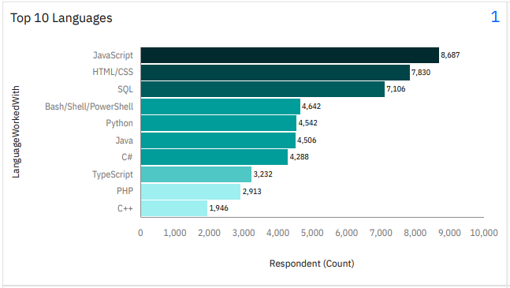
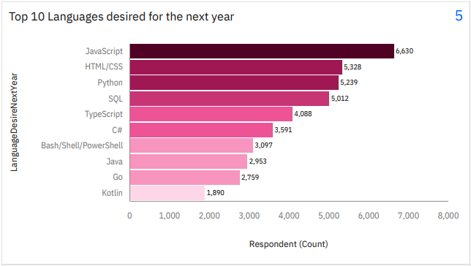
PROGRAMMING LANGUAGE TRENDS
Current Year
Next Year

Slide 8
PROGRAMMING LANGUAGE TRENDS - FINDINGS & IMPLICATIONS
Findings
JavaScript and html/CSS are the leading languages used this year
JavaScript and html/CSS are also the leading languages that respondent desires to learn next year
SQL was the third most language used this year. However, python is the third preference for next year
Implications
Demand for JavaScript / html training needs remain strong
Demand for python programing jobs is trending up. So, is the need to training courses.

Slide 9
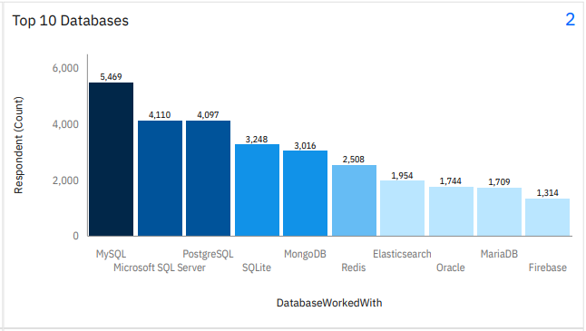
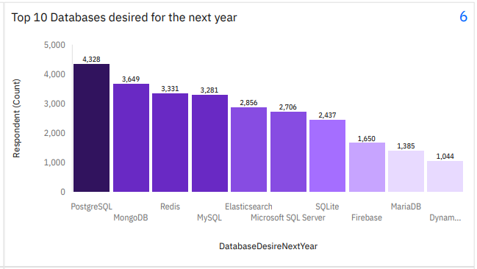
DATABASE TRENDS
Current Year
Next Year

Slide 10
DATABASE TRENDS - FINDINGS & IMPLICATIONS
Findings
MySQL is the top database used this year
PostgreSQL is the top DB to be learned next year
SQL Server is second most used DB this year, but sixth on the least of DB to be learned next year.
Implications
Big increase in demand for PostgreSQL and MongoDB learning for next year.
MySQL and SQL Server skills not as in demand from next year.

Slide 11

DASHBOARD
https://github.com/gcris07/launchpad/blob/be2b3d8099ec2b5d4d4ab9c716299df7bad74295/Technology%20Survey%20Results%20Dashboard.pdf

Slide 12
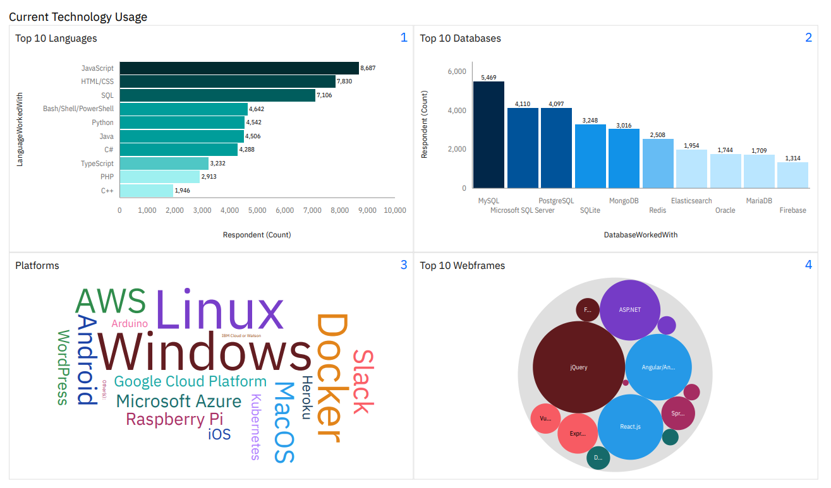
DASHBOARD TAB 1

Slide 13
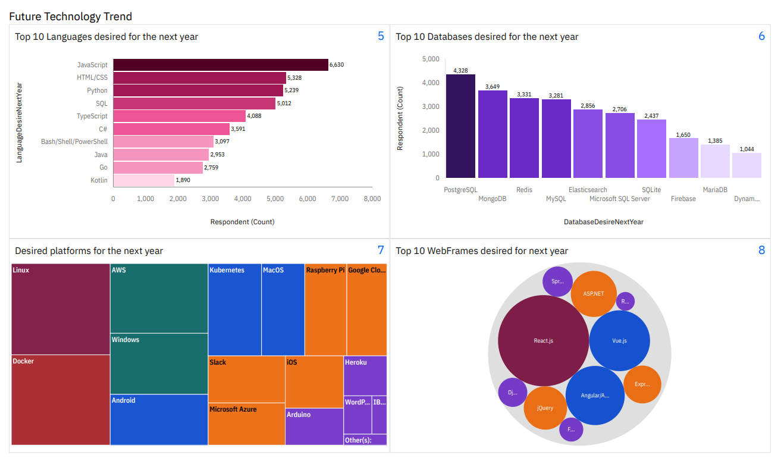
DASHBOARD TAB 2

Slide 14
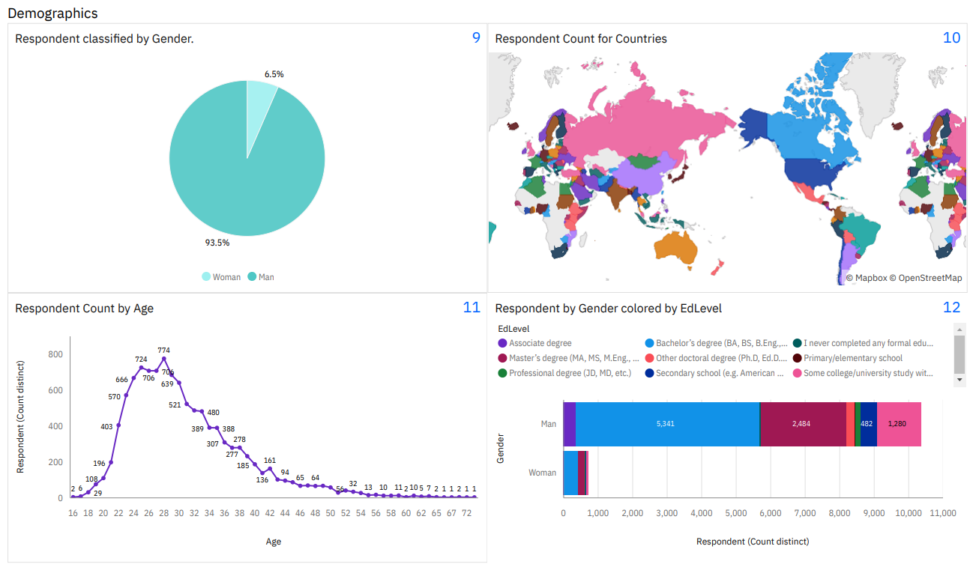
DASHBOARD TAB 3

Slide 15
DISCUSSION
Does the respondent desire to learn PostgreSQL and MongoDB as opposed to MySQL, and SQL Server next year, means there is less demand for them in terms of job opportunities?

Slide 16
OVERALL FINDINGS & IMPLICATIONS
Findings
JavaScripts and Html/CSS skills demand remain strong
Python programming skills demands is also increasing
Implications
Companies are shifting toward newer technology such as python, MongoDB, etc
Java, C, C++ programmers needs to upgrade their skill to meet demand.

Slide 17

CONCLUSION
Based on next year desire technology to learn, emphasize a trends toward newer technologies.
Man greatly over index woman in the field. Additional opportunities needs to make available to them.
To stay competitive, companies needs to take steps to insure the employees are keep up with the trends highlighted in this analysis.

Slide 18

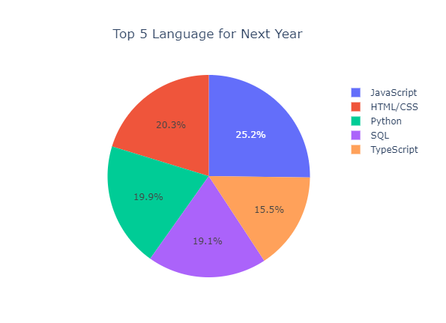
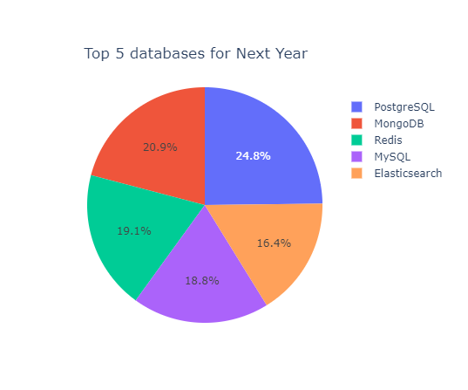
APPENDIX

Slide 19
JOB POSTINGS
Washington DC had the most job posting

Slide 20
POPULAR LANGUAGES
Swift has the most job posting followed by python.

